Slide 1
Asymptotic Notation,
Review of Functions & Summations

Slide 2
Asymptotic Complexity
Running time of an algorithm as a function of input size n for large n.
Expressed using only the highest-order term in the expression for the exact running time.
  Instead of exact running time, say Θ(n²).
Describes behavior of function in the limit.
Written using Asymptotic Notation.
Comp 122

Slide 3
Asymptotic Notation
Θ, O, Ω, o, ω
Defined for functions over the natural numbers.
  Ex: f(n) = Θ(n²).
  Describes how f(n) grows in comparison to n².
Define a set of functions; in practice used to compare two function sizes.
The notations describe different rate-of-growth relations between the defining function and the defined set of functions.
Comp 122

Slide 4

Θ-notation
For function g(n), we define Θ(g(n)), big-Theta of n, as the set:
Θ(g(n)) = {f(n) :
∃ positive constants c₁, c₂, and n_{0,} such that ∀n ≥ n₀,
we have 0 ≤ c₁g(n) ≤ f(n) ≤ c₂g(n)
}
Intuitively: Set of all functions that
have the same rate of growth as g(n).
g(n) is an asymptotically tight bound for f(n).
Comp 122

Slide 5
Θ-notation
For function g(n), we define Θ(g(n)), big-Theta of n, as the set:
Θ(g(n)) = {f(n) :
∃ positive constants c₁, c₂, and n_{0,} such that ∀n ≥ n₀,
we have 0 ≤ c₁g(n) ≤ f(n) ≤ c₂g(n)
}
Technically, f(n) ∈ Θ(g(n)).
Older usage, f(n) = Θ(g(n)).
I’ll accept either…
f(n) and g(n) are nonnegative, for large n.
Comp 122

Slide 6
Example
Θ(g(n)) = {f(n) : ∃ positive constants c₁, c₂, and n₀, such that ∀n ≥ n₀, 0 ≤ c₁g(n) ≤ f(n) ≤ c₂g(n)}
10n² - 3n = Θ(n²)
What constants for n₀, c₁, and c₂ will work?
Make c₁ a little smaller than the leading coefficient, and c₂ a little bigger.
To compare orders of growth, look at the leading term.
Exercise: Prove that n²/2-3n= Θ(n²)
Comp 122

Slide 7

O-notation
For function g(n), we define O(g(n)), big-O of n, as the set:
O(g(n)) = {f(n) :
∃ positive constants c and n_{0,} such that ∀n ≥ n₀,
we have 0 ≤ f(n) ≤ cg(n) }
Intuitively: Set of all functions whose rate of growth is the same as or lower than that of g(n).
g(n) is an asymptotic upper bound for f(n).
f(n) = Θ(g(n)) ⇒ f(n) = O(g(n)).
Θ(g(n)) ⊂ O(g(n)).
Comp 122

Slide 8

Ω -notation
For function g(n), we define Ω(g(n)), big-Omega of n, as the set:
Ω(g(n)) = {f(n) :
∃ positive constants c and n_{0,} such that ∀n ≥ n₀,
we have 0 ≤ cg(n) ≤ f(n)}
Intuitively: Set of all functions whose rate of growth is the same as or higher than that of g(n).
g(n) is an asymptotic lower bound for f(n).
f(n) = Θ(g(n)) ⇒ f(n) = Ω(g(n)).
Θ(g(n)) ⊂ Ω(g(n)).
Comp 122

Slide 9
Relations Between Θ, O, Ω
Comp 122

Slide 10
Relations Between Θ, Ω, O
Theorem : For any two functions g(n) and f(n),
f(n) = Θ(g(n)) iff
f(n) = O(g(n)) and f(n) = Ω(g(n)).
I.e., Θ(g(n)) = O(g(n)) ∩ Ω(g(n))
In practice, asymptotically tight bounds are obtained from asymptotic upper and lower bounds.
Comp 122

Slide 11
o-notation
For a given function g(n), the set little-o:
o(g(n)) = {f(n): ∀ c > 0, ∃ n₀ > 0 such that
∀ n ≥ n₀, we have 0 ≤ f(n) < cg(n)}.
f(n) becomes insignificant relative to g(n) as n approaches infinity:
lim [f(n) / g(n)] = 0
^{n→∞}
g(n) is an upper bound for f(n) that is not asymptotically tight.
Observe the difference in this definition from previous ones. Why?
Comp 122

Slide 12
Running Times
“Running time is O(f(n))” ⇒ Worst case is O(f(n))
O(f(n)) bound on the worst-case running time ⇒ O(f(n)) bound on the running time of every input.
Θ(f(n)) bound on the worst-case running time ⇒ Θ(f(n)) bound on the running time of every input.
“Running time is Ω(f(n))” ⇒ Best case is Ω(f(n))
Comp 122

Slide 13
Example
Insertion sort takes Θ(n²) in the worst case, so sorting (as a problem) is O(n²).
Any sort algorithm must look at each item, so sorting is Ω(n).
Comp 122

Slide 14
Asymptotic Notation in Equations
Can use asymptotic notation in equations to replace expressions containing lower-order terms.
For example,
  4n³ + 3n² + 2n + 1 = 4n³ + 3n² + Θ(n)
  = 4n³ + Θ(n²) = Θ(n³).
  In equations, Θ(f(n)) always stands for an anonymous function g(n) ∈ Θ(f(n))
  In the example above, Θ(n²) stands for
  3n² + 2n + 1.
Comp 122

Slide 15
Algorithms

Slide 16
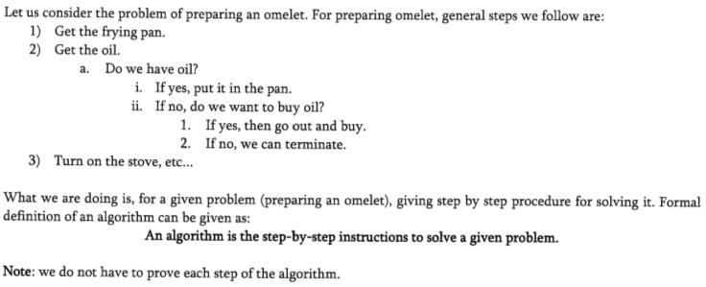

Slide 17
Definition
An algorithm is any well-defined computational procedure that takes some values or set of values as input and produces some values or set of values as output

Slide 18
Definition
A sequence of computational steps that transforms the input into output

Slide 19
Algorithms
Properties of algorithms:
Input An algorithm has zero or more inputs,
Output An algorithm produces at least one output.
Clear and Unambiguous: The algorithm should be clear and unambiguous
Definiteness of every step in the computation, Every fundamental operator in instruction must be defined without any ambiguity.
Language Independent: The Algorithm designed must be language-independent

Slide 20
Algorithms
Properties of algorithms:
Definiteness of every step in the computation, Every fundamental operator in instruction must be defined without any ambiguity.
Correctness of output for every possible input,
Finiteness An algorithm must terminate after a finite number of steps in all test cases. Every instruction which contains a fundamental operator must be terminated within a finite amount of time.
Effectiveness An algorithm must be developed by using very basic, simple, and feasible operations.

Slide 21
The Growth of Functions
“Popular” functions g(n) are
n.log n, 1, 2^{n}, n², n!, n, n³, log n
Increasing rates of growth:
1
log n
n
n log n
n²
n³
2^{n}
n!

